Slide 1


Cancer
Zackery Rogers, Luis Rojas, Hector Ladero, Akanksha Kukhraniya, Mariam Ahmad

Slide 2

Introduction
The last 50 years has seen a better understanding of the causes and treatments of cancer. Hence, the stigma, early detection and technology has improved the prognosis of cancer patients to unprecedented level.

Slide 3
Cancer Statistics
1.3 million new diagnoses cases every year
1 in 4 deaths from cancer
Early detection/Improvements in technology have improved prognosis

Slide 4
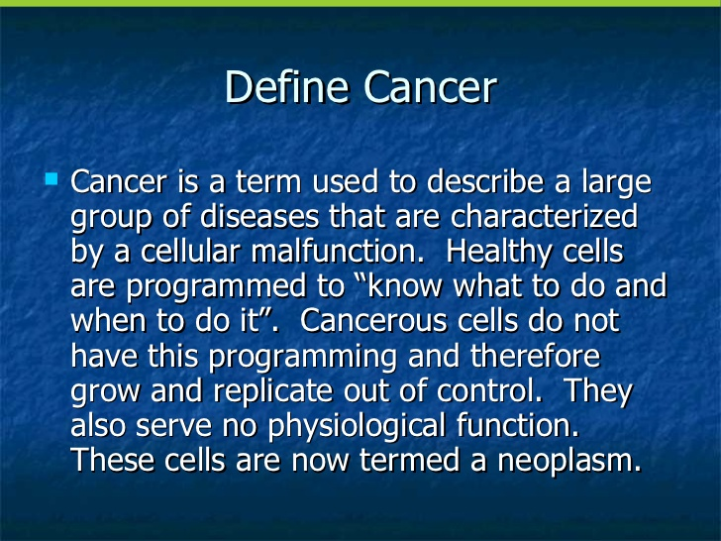
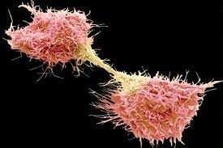

Slide 5





CDC SEER Data

Slide 6



ETL

Slide 7

Heroku

Slide 8

SEER Software

Slide 9


Slide 10
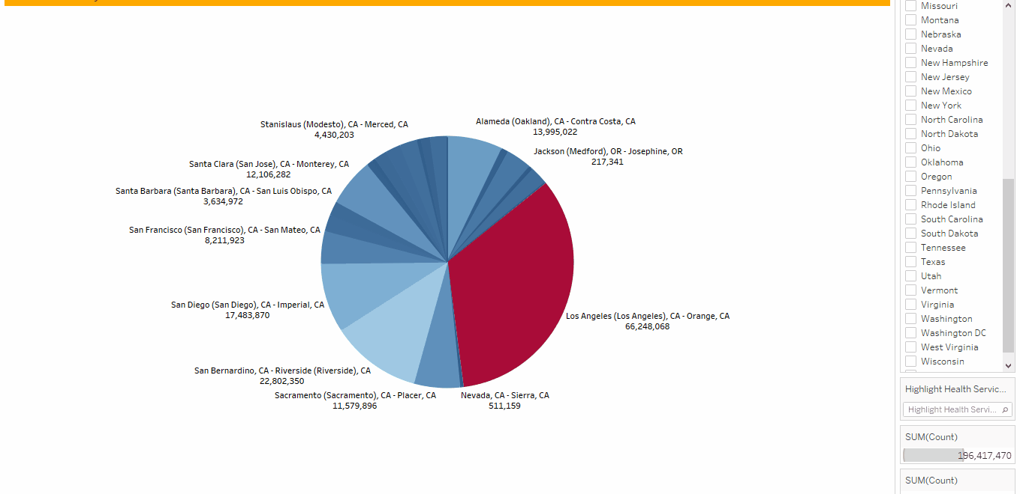

Slide 11
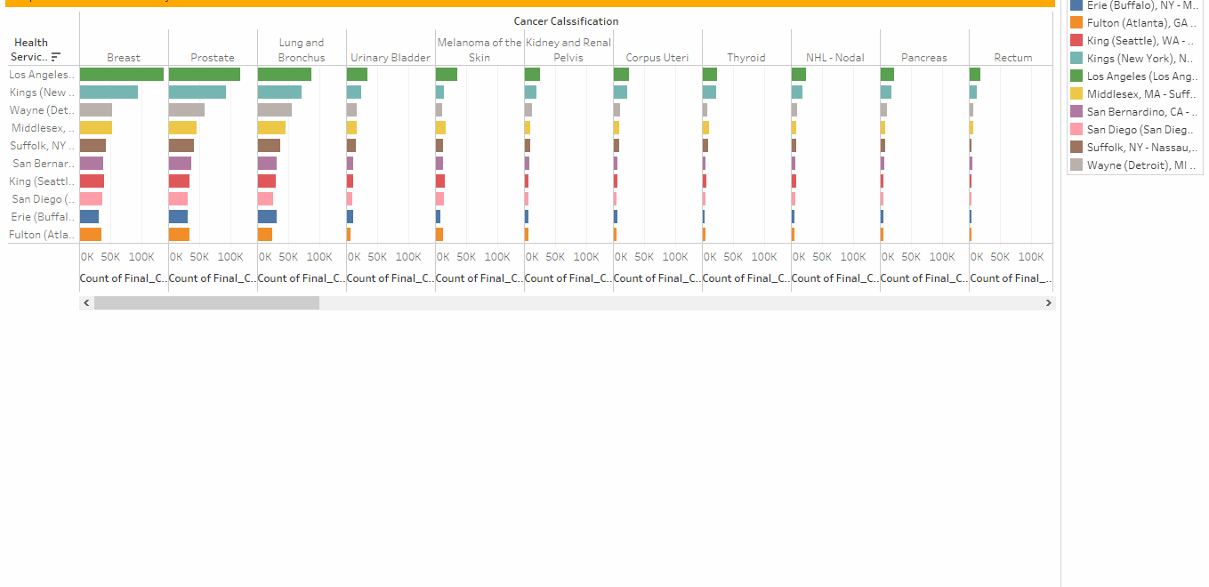

Slide 12
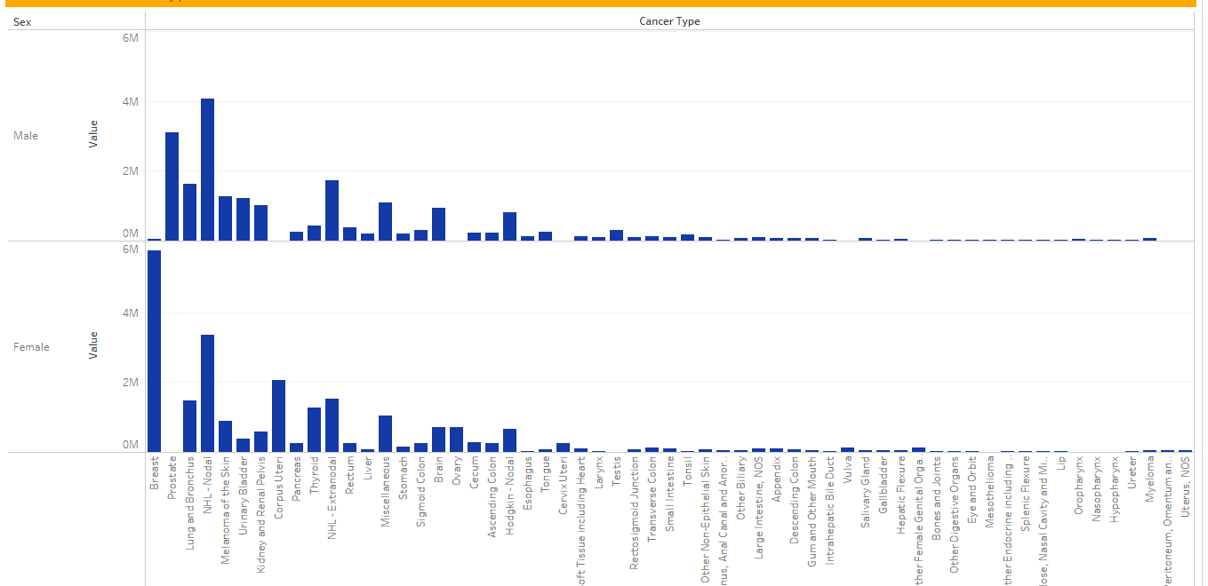
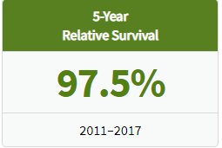
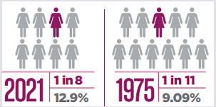
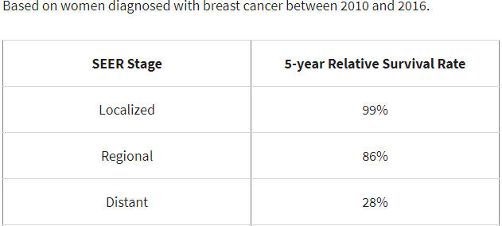

Slide 13
